Slide 1
Recurrent Neural Networks

Slide 2
Recurrent neural networks
Recurrent neural networks (RNNs) are a type of artificial neural network specifically designed to handle sequential data.
Sequential data has a specific order, each piece of data in the sequence is related to the ones before and after it.
This order provides context and meaning to the data as a whole.
Example – sentences, speech, time series data
“The quick brown fox jumps over the lazy dog.” (order of the word matters here)
“Fox brown quick the jumps over lazy dog” (meaning is lost when order of the words are not maintained)

Slide 3
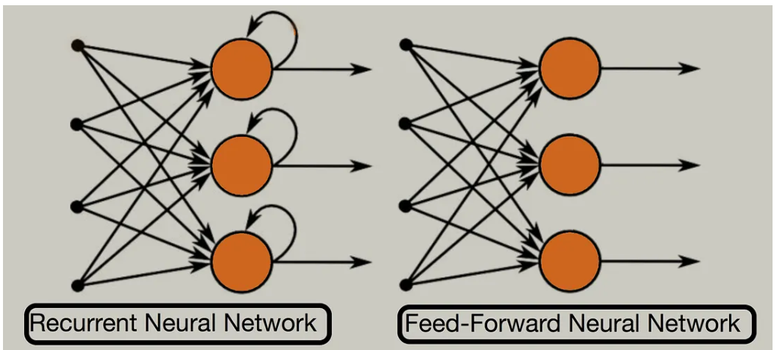
Recurrent neural networks
Unlike traditional neural networks where each input is independent, RNNs can access and process information from previous inputs.

Slide 4
Recurrent neural networks - Types
One to many
Single input, sequence of outputs
E.g. image captioning
Many to one
Sequence of inputs, single output
E.g. sentiment analysis
Many to many
Sequence of inputs, sequence of outputs
E.g. machine translation, text summarization

Slide 5
Sequential processing in RNN
Sequential processing is the core idea in RNN.
One element is processed at a time, the order is maintained.
Example: “I love AI”
Time | Input | Memory (h)
t₁ | I | remembers "I"
t₂ | love | remembers "I love"
t₃ | AI | remembers full sentence

Slide 6
Memory in RNN
Memory is maintained by the hidden state (h_{t}), which is the output of the hidden layer at time t.
At each step:
h_{t} = f(Wx_{t} + Uh_{t-1})
Where, h_{t-1} – previous memory
h_{t} – updated memory
Each hidden state carries past information, which is updated with new input.

Slide 7
RNN example
Review | Label
good movie | 1
bad movie | 0
good nice movie | 1
bad boring movie | 0
Word | Value
good | 1
nice | 0.8
bad | -1
boring | -0.8
movie | 0.5
Dataset
Step 1: Word encoding

Slide 8
RNN Example
Step 2: RNN setup
h₀ = 0
W = 1
U = 0.5
Activation = identity (no transformation is applied on the output)

Slide 9
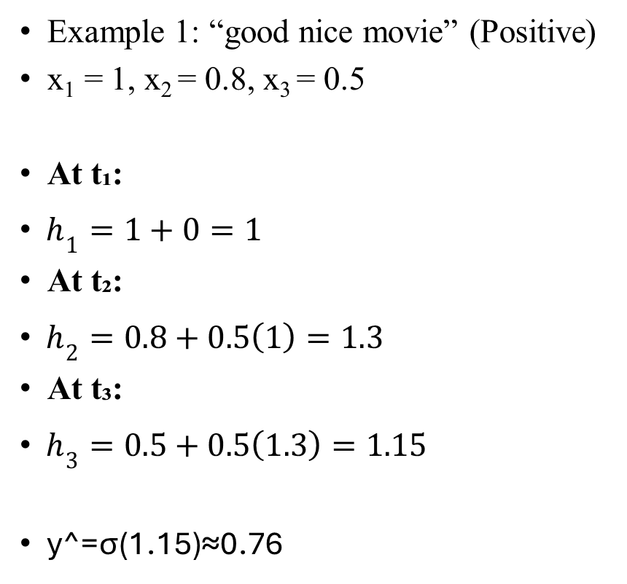
RNN Example
Example 1: “good nice movie” (Positive)
x₁​ = 1, x₂ ​= 0.8, x₃ ​= 0.5
At t₁:
$h_{1}=1+0=1$
At t₂:
$h_{2}=0.8+0.5\left(1\right)=1.3$
At t₃:
$h_{3}=0.5+0.5\left(1.3\right)=1.15$
y^​=σ(1.15)≈0.76

Slide 10
References
https://www.youtube.com/watch?v=aircAruvnKk&list=PLZHQObOWTQDNU6R1_67000Dx_ZCJB-3pi

